Slide 1

Battery early cycle life prediction through deep learning
Yu-chi Tsao

Slide 2
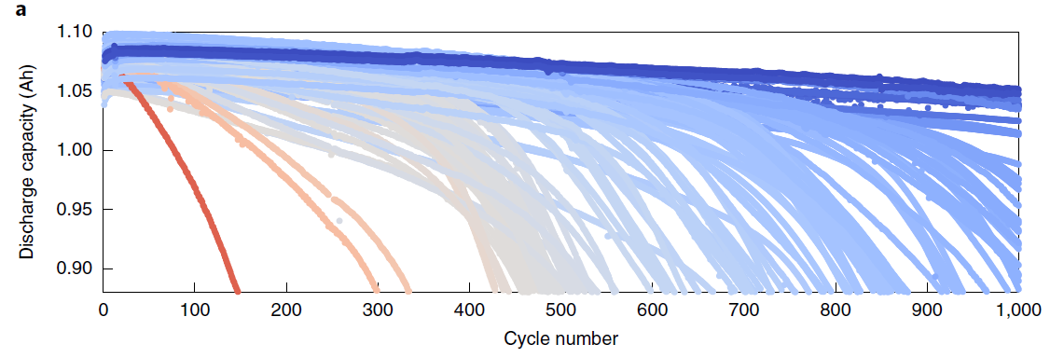
Background
Long battery lifetime entails delayed feedback of performance
Nature Energy, 2019, 4, 383-391
Notes:
To get the battery cycle life, typically the cell needs to run very very long cyles , which takes a lot of time to get the feedback of the performance.
So, one of the motivation is to create a deep learning model to predict the cycle life to save time.
However, one of the challenges is that there are many different battery degradation process, for examples, it may involve SEI growth, lithium plating, prorousty changes, structure degradation. and typically its non-linear degradation processHence, it is challenging to have accurate early prediction of cycle life.

Slide 3
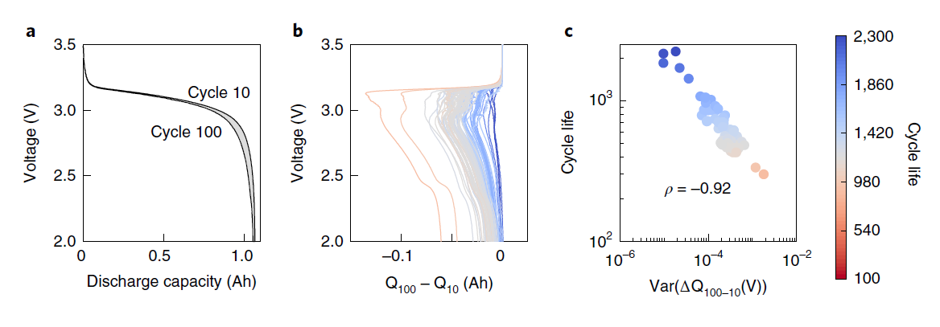
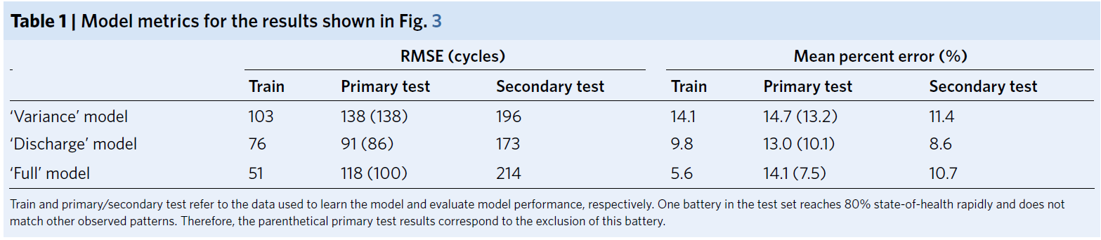
Inspiration and Motivation
Found Variance of ΔQ100-10(V) (log scale) has high correlation to the cycle life
(energy dissipation on voltage)
Get 9.1% test error for quantitatively predicting cycle life using the first 100 cycles
4.9 % test error using the first 5 cycles for binary classification
Discharge model : six features based on only on discharge cycle information
Full model : nine features (adding temperature, resistance)
Nature Energy, 2019, 4, 383-391
Notes:
And thanks for this paper and I was very amazed about the results which it shows capability of using data driven model (machine learning model) to predict the cycle life by using early cycle data. And this paper found the log of variance of the delta Q has high correlation to the cycle life. The detla Q is the energy dissipation on voltage And just by using this – delta Q as the predictor, the mean test percent error can be around 14-11%. And through adding other predictor such as discharge cycle information or adding temperature, resistance, the error can be reduced further to 8.6 or 10. I was very amazed about the results and it really motivate me to take data related class. And when I take the deep learning class, I decided to think maybe I can try to use the deep leanrning model to predict the battery cycle life!!

Slide 4
Deep learning v.s Machine learning
Machine learning
Deep learning
Advantage of deep learning model:
No need to have domain knowledge / Worry less about the feature engineering
Deep learning outperform other technique if the data size is large
Can deal with complex problems. ex. image classification, natural language processing.
Disadvantage of deep learning model:
Computation power
Less interpretability
https://blog.thinkwik.com/insights-of-the-machine-learning-and-the-deep-learning/
Notes:
And one of the major difference of using the deep learning model compared with machine learning model, you worry less about the feature engineering. For example, take this battery early cycle prediciotn from the paper as an example, they first figure out the important predictor(delat Q) and also tried to find out other predictors and then do the classification.
But for the deep learning model, you actually throw all the information into it and the neural net work do the feature extraction and classifiarion and then make the output.
And other advantages that ….

Slide 5
Data set (from Toyota research institute)
allocate 60% of our total to the train set, 20% to the validation set, and 20% to the test set.
preprocessed our dataset by normalizing and shuffling and removing battery cells that does not reach 80% capacity and noisy channels resulted from instrument noises.
Cycle life is defined as the number of cycles until 80% nominal capacity.
to use binary classification, we classified cell into “low-lifetime” (y = 0 when cycle life < 550) and “high-lifetime” (y = 1 when cycle life ≥ 550).
Notes:
To do the model prediction, we first need to preprocess and organize the data to use as the model input. We first collected the data from the Toyota research institute and for each cell each cycle has information of cycle number, discharge capacitu,,…
then preprocess by normalizing and shuffling the data and remove so cell dara that does not reach to 80% capacity and noisy channels resulted from instrument noises.
Given we don’t’ have many data we allocate and to be big enough to give high confidence in the overall performance for the system， And we first allocate 60% of total to the training , 20…
And then for example, if we are using 100 cycle information as the input, we will organize into the matrix which you have total of 800 features, because you have 100 cycles and 8 distinct feature and then each column represent each cell data.
And here we used binary classificaitom, we classified cell into “low-lifetime” (y = 0 when cycle life < 550) and “high-lifetime” (y = 1 when cycle life ≥ 550).
The size of the validation and test set: big enough to give high confidence in the overall performance for the system

Slide 6
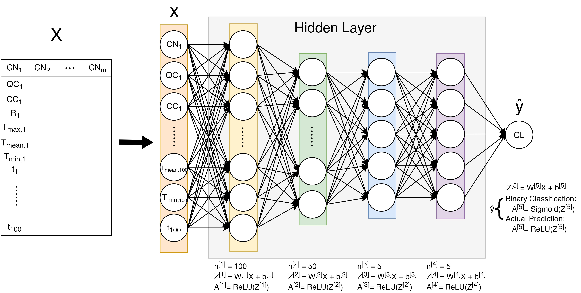
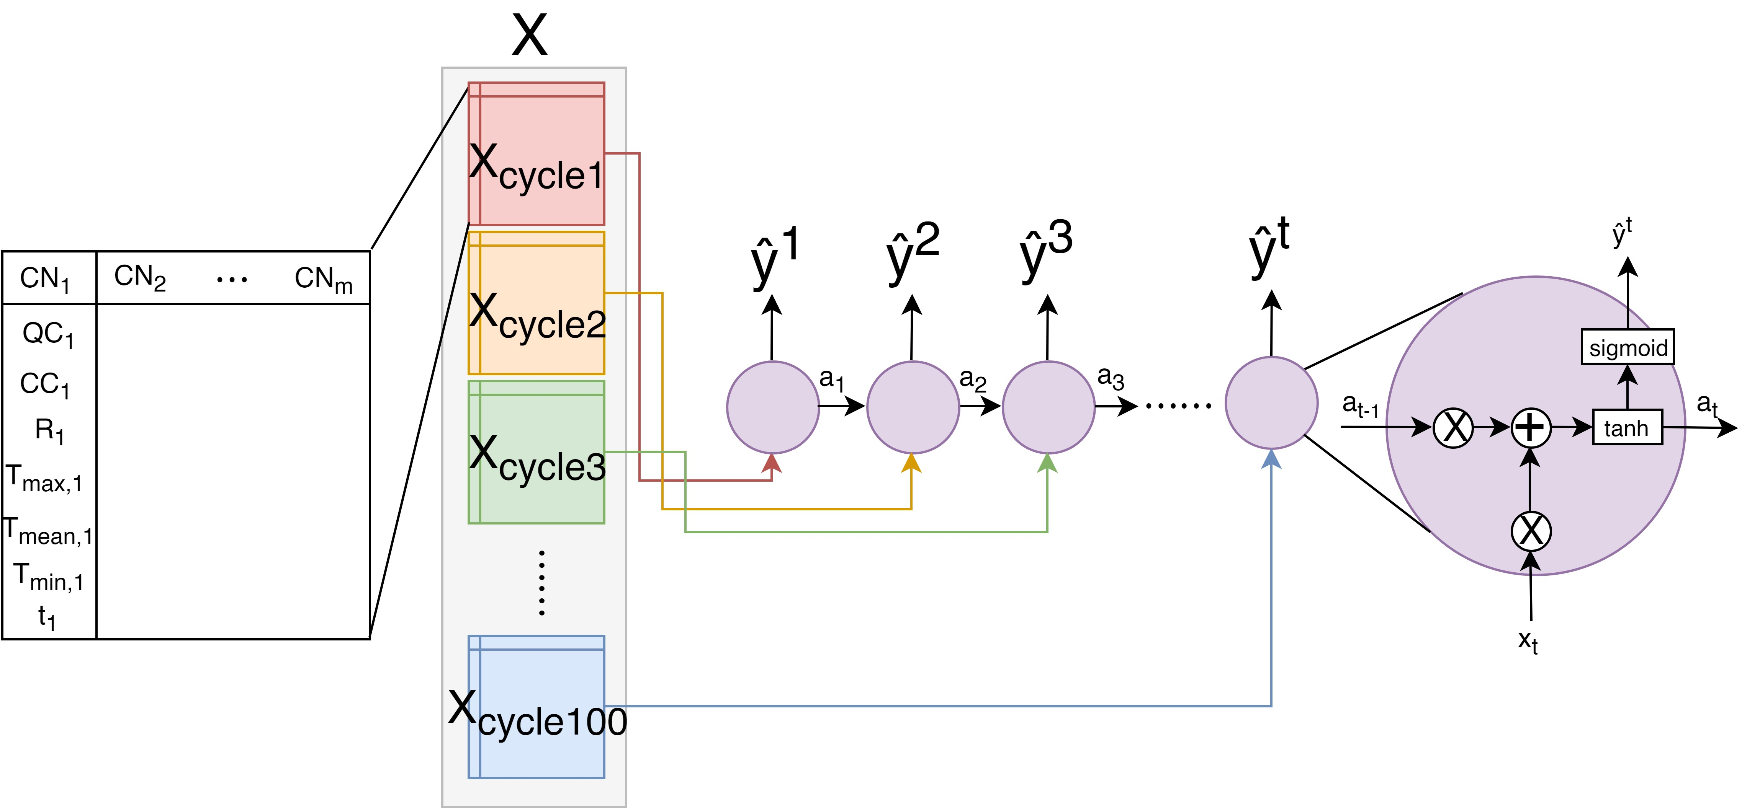
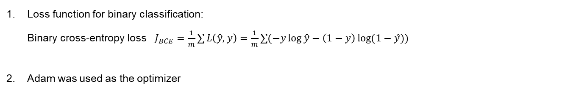
Method/Model
Loss function for binary classification:
Binary cross-entropy loss $J_{BCE}=\frac{1}{m}\sum{L\left(\hat{y}, y\right)}=\frac{1}{m}\sum{(−y\log{\hat{y}}−\left(1−y\right)\log{(1−ŷ)})}$
Adam was used as the optimizer
Fully-connected neural network (FCNN) model
Recurrent neural network (RNN) model
Notes:
And then we used the binary coress entropy loss (typical loss function to update the parameter) and adam was used as the optimizer to optimize faster
And the model we first try used is Fullly connected neural network. And then we also used RNN because this model has been shown to have good performance in the time-series data.
RNN allows to exit temporal dynamic behavior Compared with the FCNN, which you first input all the data and each layer get the estimate from the previous layer, and then predict the cycle life
For the RNN, it tries to predict the cyclife every time it throws a cycle information. Like here for y3 here, when it predict the cycle life, it is based on the previous estimate (calciated from first and second cycyle) and then the cycle 3 information
Which allows the model to track the temporal information.

Slide 7
Optimization/Result
Result for binary classification / FCNN model
First n cycles with best learning rate (LR) | 5 cycles | 10 cycles | 50 cycles | 100 cycles
 | LR=0.001 | LR=0.001 | LR=0.001 | LR=0.001
Training accuracy (%) | 100 | 100 | 100 | 100
Validation accuracy (%) | 92 | 100 | 100 | 93
Test accuracy (%) | 83 | 88 | 87 | 94
Learning rate was optimized based on the test accuracy.
Compared between validation accuracy and test accuracy, there was over-fit issues.
→ Early-stopping was implemented, and test accuracy could be slightly improved using 5 cycles or 10 cycles
First n cycles with best learning rate (LR) | 5 cycles | 10 cycles | 50 cycles | 100 cycles
 | LR=0.001 | LR=0.001 | LR=0.001 | LR=0.01
Training accuracy (%) | 99 | 97 | 99 | 99
Validation accuracy (%) | 100 | 90 | 100 | 100
Test accuracy (%) | 85 | 90 | 85 | 87
Notes:
Here this is the result of using 5, cycle, 10 cycle, 50 cycles and 100 cycles, we and the learning rate is optimized based on the validation accuracy.
From the result here we shows that we can achieve 83 accuracy when using 5 cycles to predict the cycle life.
Compared between the validation accuracy and test accuracy we see that the there is overfit issues, and when we plot cost v.s dev set, we saw the dev cost increase after around 50 iterations. Do we also implement early stopping and the test accuracy is slightly improved from 83 to 85 when using 5 cycles.

Slide 8
FCNN v.s RNN
Result for binary classification / FCNN model
First n cycles with best learning rate (LR) | 5 cycles | 10 cycles | 50 cycles | 100 cycles
 | LR=0.001 | LR=0.001 | LR=0.001 | LR=0.01
Training accuracy (%) | 99 | 97 | 99 | 99
Validation accuracy (%) | 100 | 90 | 100 | 100
Test accuracy (%) | 85 | 90 | 85 | 87
Result for binary classification / RNN model
First n cycles with best learning rate (LR) | 5 cycles | 10 cycles | 50 cycles | 100 cycles
 | LR=0.0005 | LR=0.0005 | LR=0.0005 | LR=0.0005
Training accuracy (%) | 96 | 97 | 98 | 98
Validation accuracy (%) | 100 | 91 | 95 | 91
Test accuracy (%) | 95 | 87 | 87 | 95
The test accuracy using only first 5, 10, 100 charge-discharge cycles with RNN shows better performance than fully-connected network.
Compared with machine learning model which has 95.1 test accuracy using the first 5 cycles, the deep learning model can also achieve similar performance.
Notes:
Ｃompared the model result between FCNN and RNN, we can see with using the RNN, using 5, 50 and 100 , the accuracy get improved. It demonstrate tha tusing RNN shows better performance than FCNN.
And most interestly compare dwith the machine leanrin model that I just show you previously, we can achieve similar performance with 95 % test accuracy using the first 5 cyle information to predict the cycle life

Slide 9
Conclusion & Outlook
Deep learning model (RNN and FCNN) was applied to predict battery cycle life using early cycle data (binary classification).
RNN model performs better than FCNN
Compared with machine learning model which has 95.1 test accuracy using the first 5 cycles, the deep learning model can also achieve comparable performance. Without knowing the important feature (ΔQ), deep learning model did show the ability to achieve similar performance.
Using X-ray tomography images taken before cycling may potentially be used to detect manufacturing defect with using deep learning model.
Notes:
The conclusion

